Slide 1
Physical Market Structures: CRUDE, Natural Gas, Power & NG Liquids

Slide 2


Slide 3
Supply & demand revolution

Slide 4
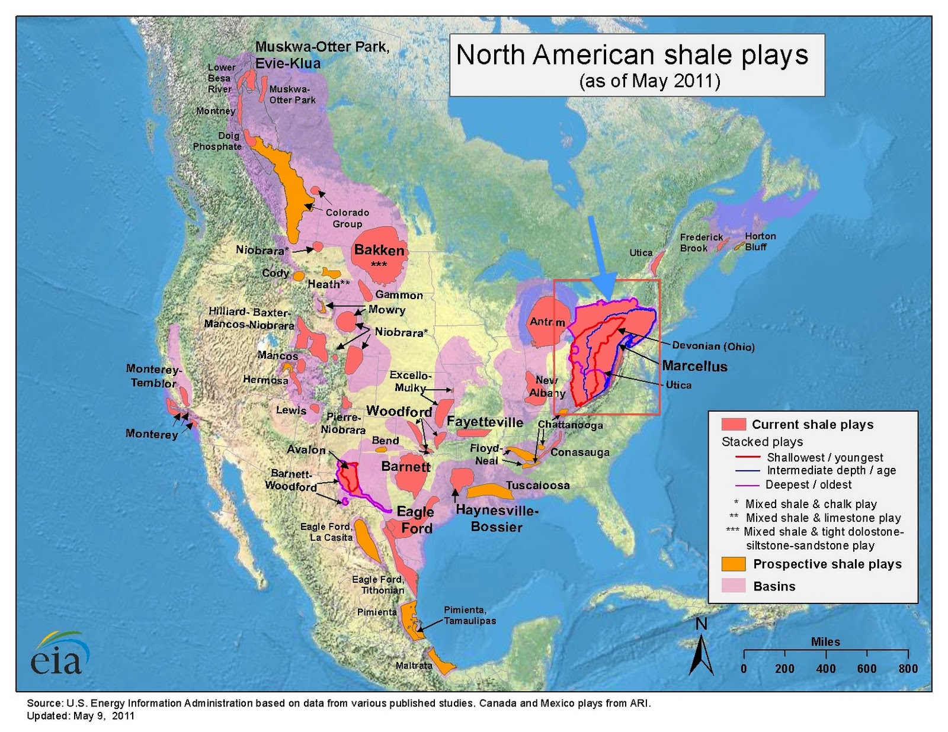
North American Producing Basins
Notes:
Natural gas resources are distributed between a number of major geologic basins. Most U.S. natural gas is produced in the onshore and offshore regions of the Gulf coast. According to 2001 data, 60 percent of gas produced in the United States flows from the onshore and offshore areas of the Gulf of Mexico. Another 23 percent was produced in New Mexico, Oklahoma, and Wyoming.
Many major consuming markets (e.g., the Northeast, Midwest, California, and Florida) are located at significant distances away from the producing regions, so the system depends on the pipeline network.
The interstate pipeline network consists of almost 300,000 miles of pipe.
(The map shows major geologic basins and transportation corridors. The relative size of transportation flows is reflected in the size of the arrows. The basins, on the other hand, are represented in terms of the area in which the basins lie. The largest basins on the map are not necessarily the most prolific.)

Slide 5
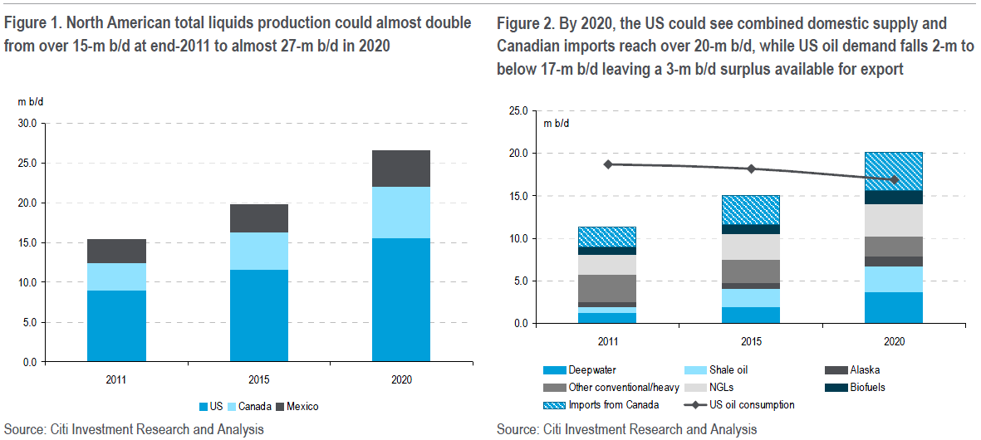
Supply Revolution

Slide 6
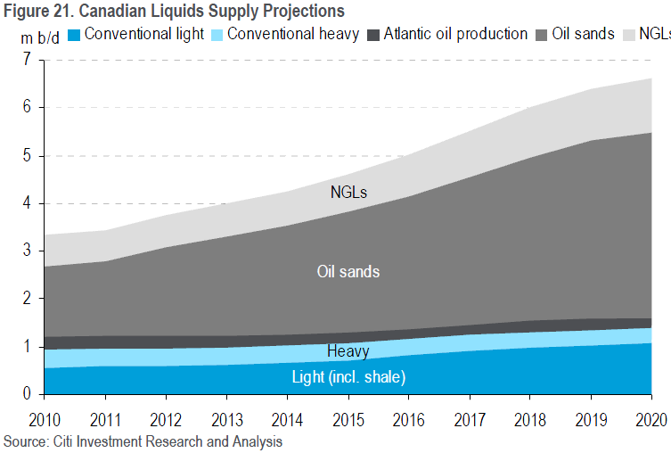

Slide 7
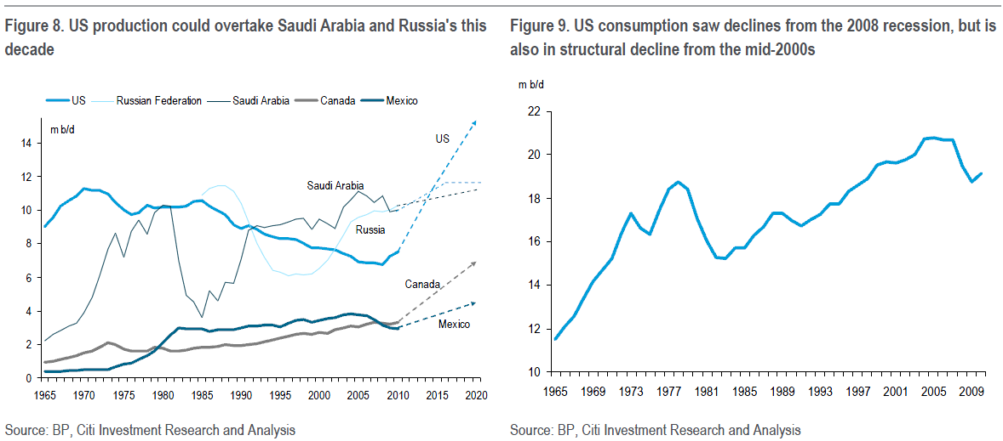
Could this have been predicted 5 years ago?

Slide 8
Crude Oil

Slide 9
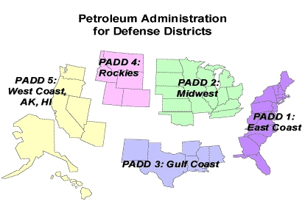
PADD Locations

Slide 10
Crude Oil Spreads
Geographic Region | Crude Oil | API Weight | Sulfur Content (%) | Average 2008 Price | Average 2011 Price
North Sea
 | Dated Brent | 38.5 | 0.40 | 97.69 | 111.05
 | Oseberg | 35.4 | 0.26 | 99.87 | 113.01
 | Ekofisk | 42.3 | 0.15 | 97.69 | 112.83
West Africa
 | Bonny Light | 34.5 | 0.10 | 97.69 | 113.53
 | Cabinda | 32.5 | 0.13 | 94.59 | 110.45
Mediterranean
 | Iran Heavy | 31.0 – 32.0 | 1.80 | 89.77 | 106.57
 | Iran Light | 33.5 – 34.0 | 1.40 | 94.15 | 108.07
Persian Gulf
 | Dubai | 31.2 | 2.01 | 93.97 | 106.15
 | Oman | 37.0 | 1.08 | 99.54 | 106.66

Slide 11
Crude Oil Spreads
Geographic Region | Crude Oil | API Weight | Sulfur Content (%) | Average 2008 Price | Average 2011 Price
Australia
 | Cossack | 49.0 | 0.04
 | Gippsland | 48.0 | 0.10
 | Griffin | 55.0 | 0.03
China
 | Daqing | 32.7 | 0.10 | 92.41 | 117.45
Indonesia
 | Attaka | 44.7 | 0.04 | 101.14 | 121.46
 | Widuri | 33.3 | 0.07
United States
 | (WTI) | 38.0 – 40.0 | 0.30 | 99.92 | 95.05
 | (WTS) | 33 | 0.16 | 96.15 | 93.00

Slide 12
Light/Heavy Spread
Source: S&P’s DRI/Platts
Notes:
The light-heavy crude oil price difference can fluctuate quite a bit in the short term. However, this graph shows that, while there are some significant cyclical ups and downs, there is no sign of increasing differentials trendwise.
That is, as yet, there is no sign of a major shift to heavy crude oil advantage relative to history.
But will this continue in to the future?
Updated 9/29/2010

Slide 13
Light/Heavy Spread

Slide 14
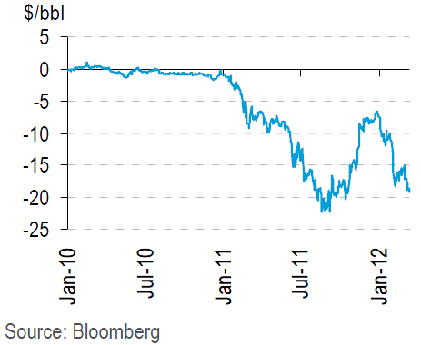
WTI / Brent Spread: The Bakken Shale

Slide 15
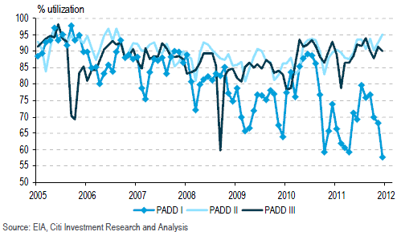
WTI / Brent Spread has helped PADD II & PADD III Refineries / Hurt PADD I

Slide 16
Natural Gas

Slide 17
General Factors Affecting Natural Gas
Demand Shock:
2008 Recession decrease natural gas consumption to 1998 levels
Lower 48 currently consuming approximately 55 BCF / D
Supply Shock:
Natural gas domestic production has increased 10% during that time
2008 Daily Production – 45 BCF /D
2011 Daily Production – 55 BCF / D
Reasons:
Shale & horizontal drilling technology
North American Reserves have skyrocketed
Shale drilling being driven by liquids prices, not NG prices

Slide 18
Two Eras: Natural Gas Price Chart
Notes:
(These prices are based on weekly samples.)
What caused the spike in early 2002? War in Iraq.
Not updated - bloomberg

Slide 19
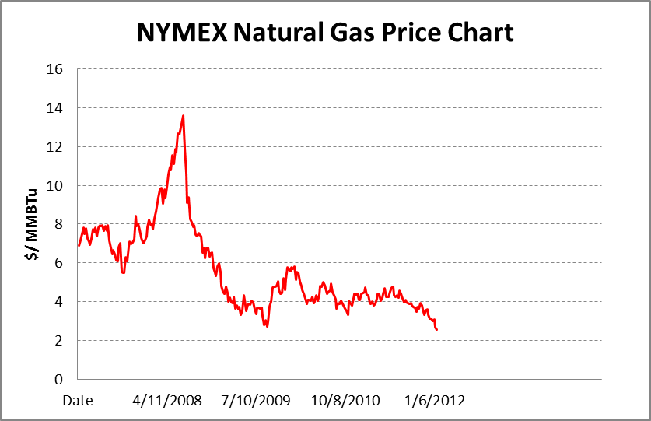
Year Natural Gas Price Chart

Slide 20
Natural Gas Historical Volatility
Notes:
Volat was calced based on 30 days of data and then ann’zed by mult by sqrt 252.
Not updated - bloomberg

Slide 21
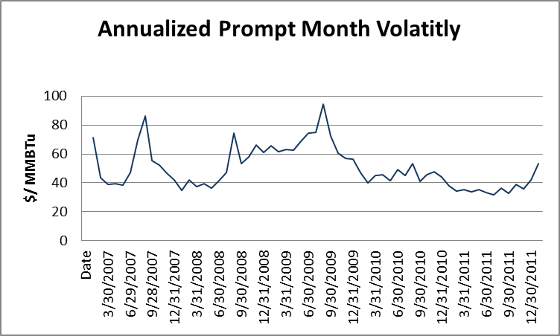
Natural Gas Historical Volatility

Slide 22
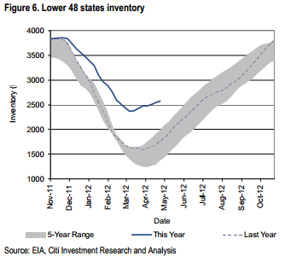
Natural Gas Storage Effects, May 2012

Slide 23
Natural Gas Demand Changes (2015)
Coal Plant Retirement
Commercial Demand
North American feedstock will be lowest in world with the exception of Qatar
Manufacturing Boom
Chemicals Boom
Residential / Commercial Demand
Replacing less green (heating oil) boilers with natural gas boilers
Housing overhang being worked though
LNG Export
At $6/mmBTU
LNG to Asia: $10 / mmBTU
Asian Price - $85/mmBTU
CNG Vehicles

Slide 24
Natural Gas Liquids (NGL)

Slide 25
Historic NGL Pricing
Notes:
Not updated - bloomberg

Slide 26
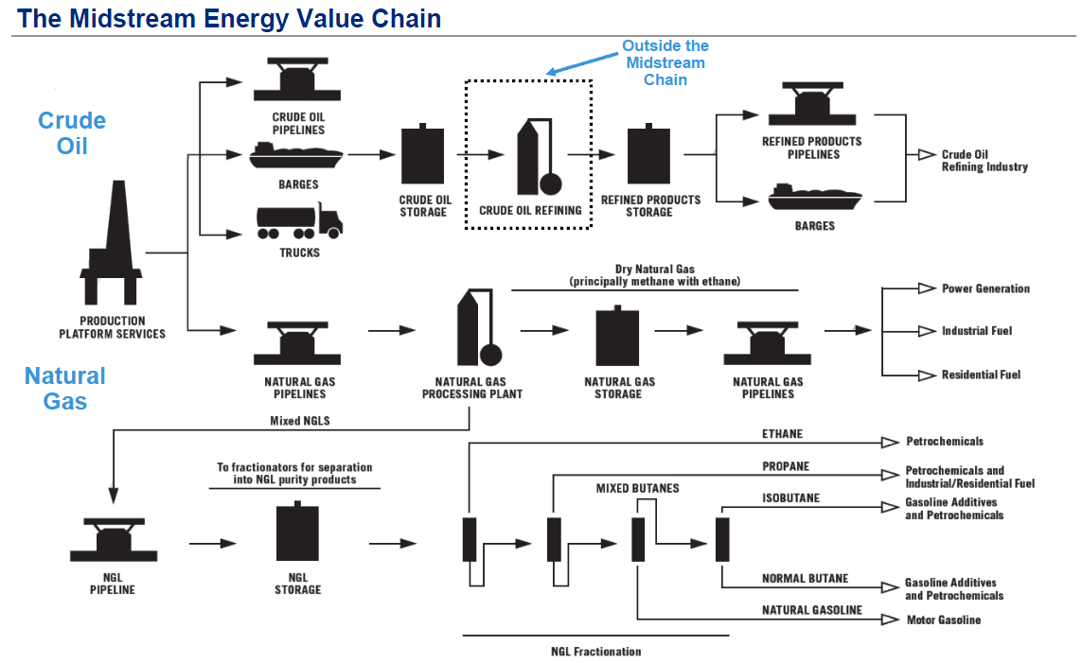

Slide 27
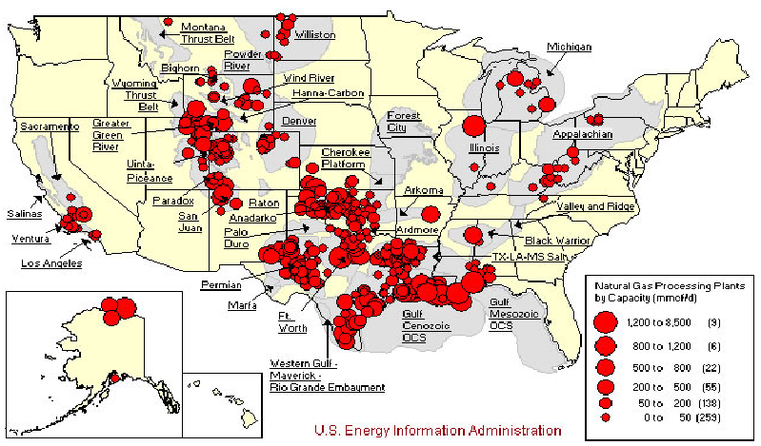
Natural Gas Liquids: Supply Areas
Notes:
Unlike the interstate natural gas market, all of these subregions are both supply and demand areas.
Mention PJM & COB.

Slide 28
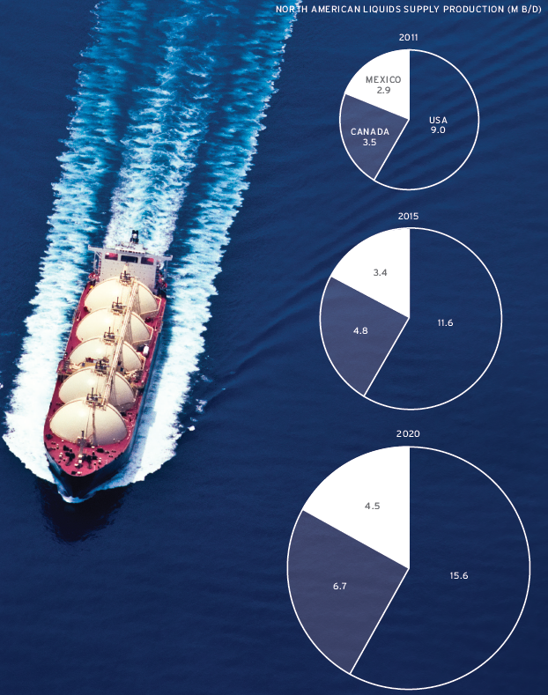

Slide 29
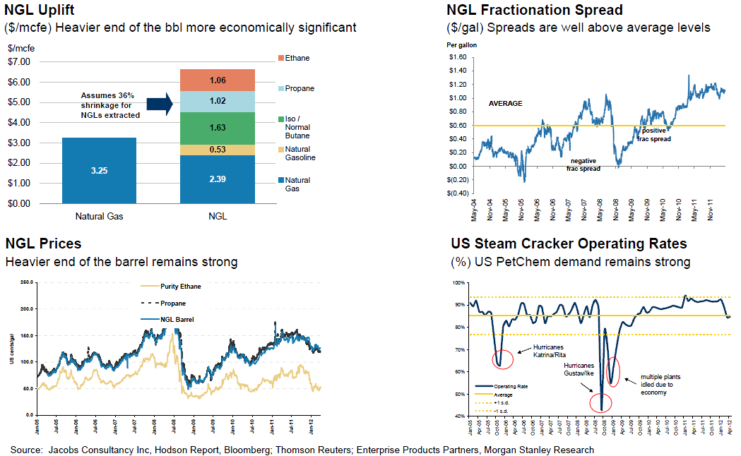

Slide 30
NGL Market Hubs
Edmonton/Fort Saskatchewan, Alberta
Sarnia, Ontario
Conway, Kansas
Mont Belvieu, Texas
Because of physical infrastructure, Mon Belvieu acts as a “price setter” for the other three regions

Slide 31
NGL Pricing
Most contracts are priced as an index to one of the four locations
NGL prices typically track/follow crude oil prices.
Ethane is the exception tracking natural gas prices
Propane trades near 75% to crude oil
Butane trades near 85% to crude oil
These relationships change as natural gas prices trade high in relation to crude oil prices (2000 – 2001)
NGL processors will sell the heavier components in the natural gas when natural gas prices are high

Slide 32
NGLs provide a significant revenue boost to NG
NGLs price, % of WTI
Comparing well revenues
Price for Haynesville well
to match Eagle Ford
Source: EIA, company reports, Barclays Capital equities and commodities research

Slide 33
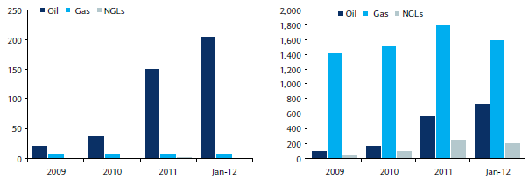
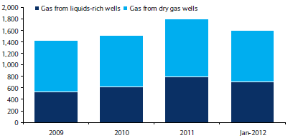
Associated gas: Eagle Ford
Production from oil window (MMcfe/d)
Production from liquids window (MMcfe/d)
Gas production by source (MMcf/d)
Eagle Ford gas rig count
___________________________
Source: The Railroad Commission of Texas, company reports, Barclays Research
33

Slide 34
Electricity

Slide 35
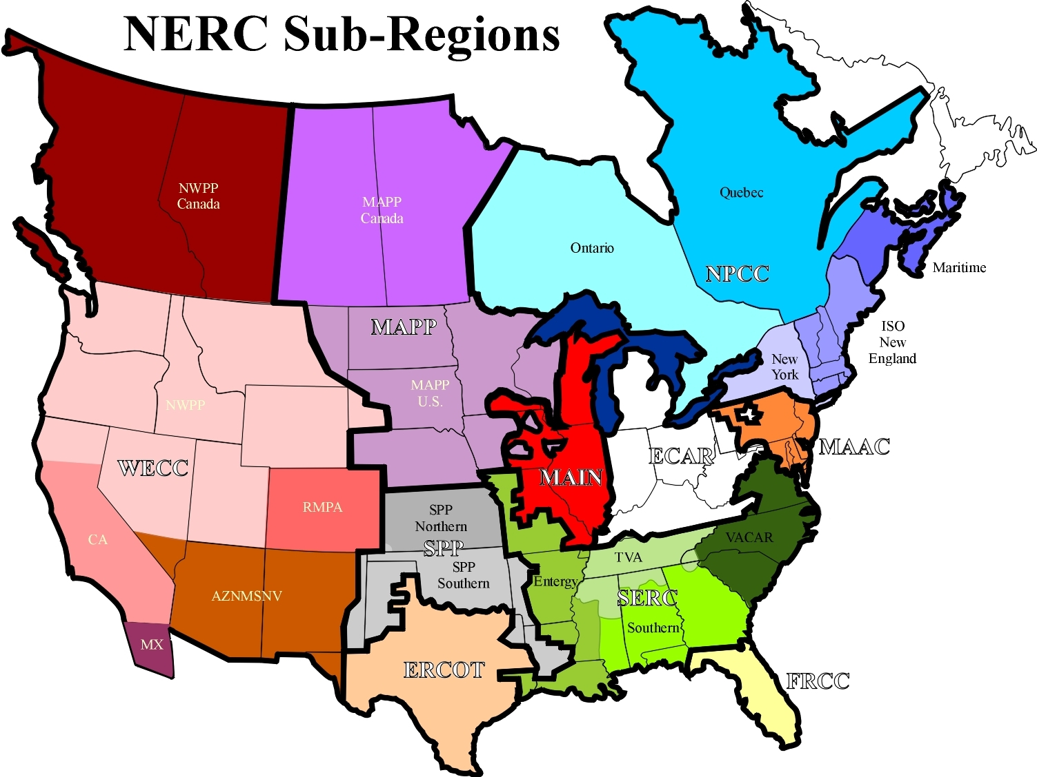
Power: Major Regions
Source: http://www.nerc.com
Notes:
Unlike the interstate natural gas market, all of these subregions are both supply and demand areas.
Mention PJM & COB.

Slide 36
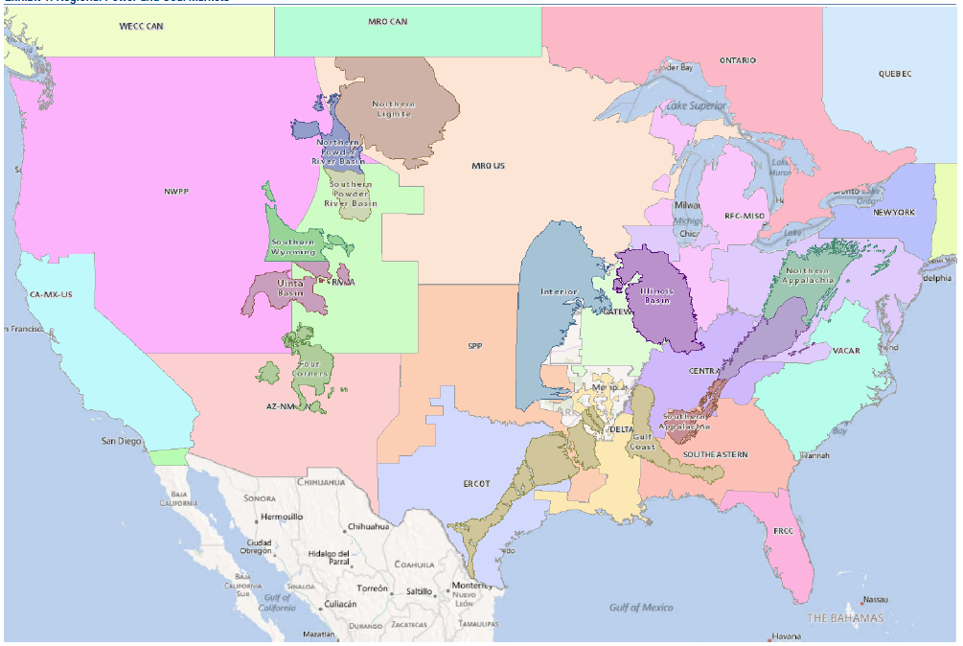
Regional Power & Coal Markets (2012)

Slide 37
Power Supply = Market Areas
Transmission
Constraints
Between
Regions
Different
Supply
Cost & Mix
Across
Regions
Differing Prices & Low Price Correlation Across Regions.
Note that this explains why basis swaps are not common in power trading.
Notes:
Arbitrage opportunities across regions are often very temporary, even if price discrepancies remain.
Is anything common in power trading?

Slide 38
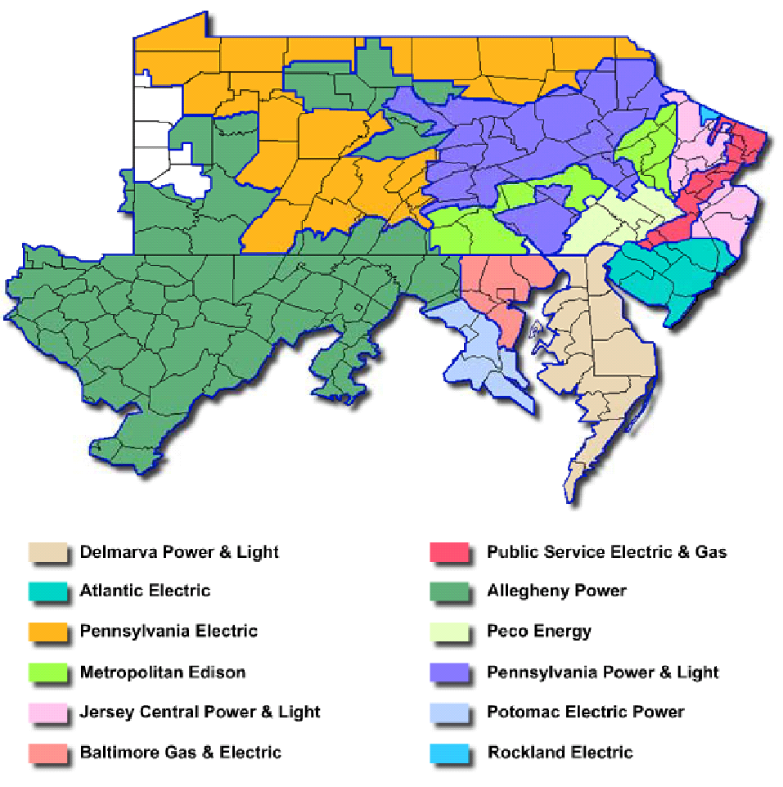
Intra-Region Basis Prices
Source: http://www.pjm.com/documents/maps/pjm-zones.pdf
Notes:
Within MAAC is the PJM Regional Transmission Organization (RTO). Prices vary even within PJM such as the PJM East vs PJM West price quotes.

Slide 39
Electricity Issues
Green Power has not worked
Conversion to Natural Gas
Decommission of Coal Plants
Conversion to Natural Gas
What happens when gas prices increase?
Capacity markets
Hub transmission markets
Price Caps

Slide 40
Annual average boost to gas consumption via coal displacement (vs. 2008 base year)
~10% of total gas consumption
~10% loss in coal market share since 2008
Bcf/d
___________________________
Source: EIA, Barclays Capital.
40

Slide 41
At what price does gas compete with coal? (Gas-equivalent prices and volume of all coal in the US, October 2011 data, includes transportation costs)
2010 gas prices
2011 gas prices
Current gas price
___________________________
Source: Barclays Capital.
41

Slide 42
Negative margins weigh on coal plant retirement decisions (un-contracted coal plants)
Falling forward gas prices challenge
coal, $/MMBtu (incl. transport costs)
Mid-Atlantic power market cash
coal plant margins, $/MWh
Eastern US coal plant margins,
$/MWh (2013-2014)
Western US coal plant margins,
$/MWh (2013-2014)
___________________________
Source: ICE, Platts, CME, Barclays Capital.
42

Slide 43
Physical Markets
Regional for all commodities
Price differentials occur via location
Arbitrages can occur from short term demand spikes
Arbitrages can occur between physical and financial markets

